Slide 1
Mission Prep Life Skills
Annette Anderson

Slide 2
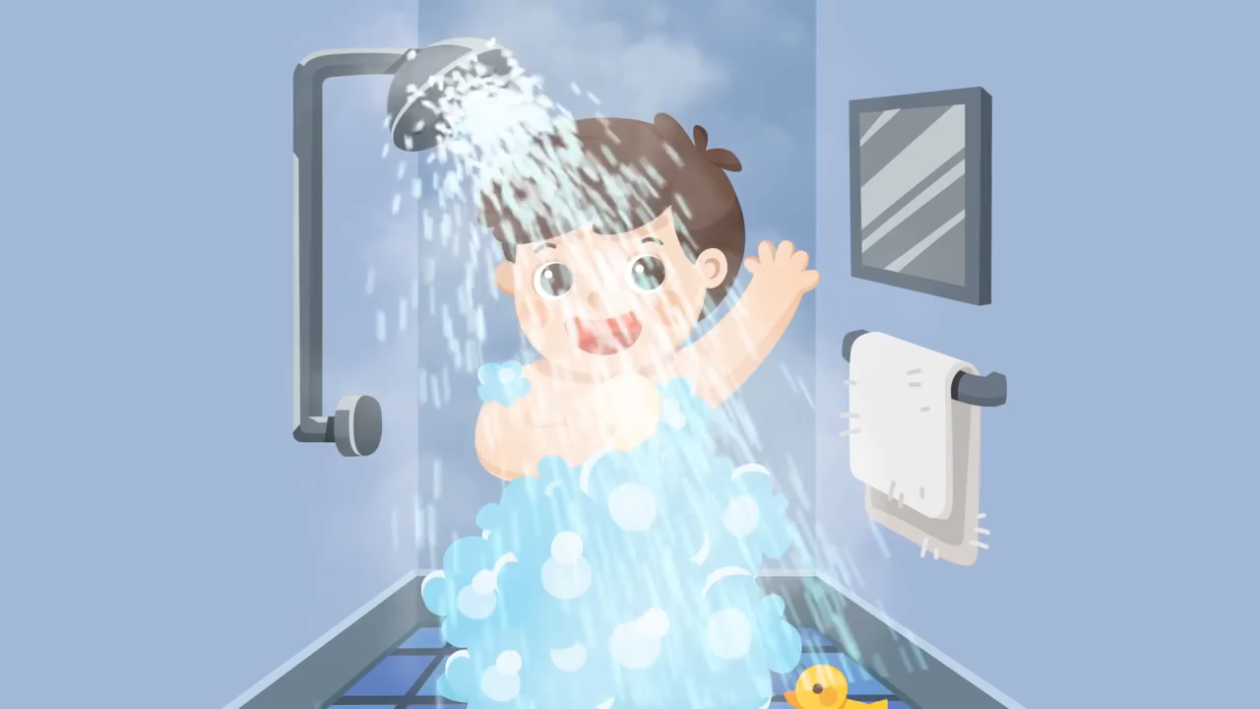
Personal Hygiene

Slide 3
Taking Care of Your Clothes
Read Labels for washing instructions
Sort Clothes
Stain Removal

Slide 4
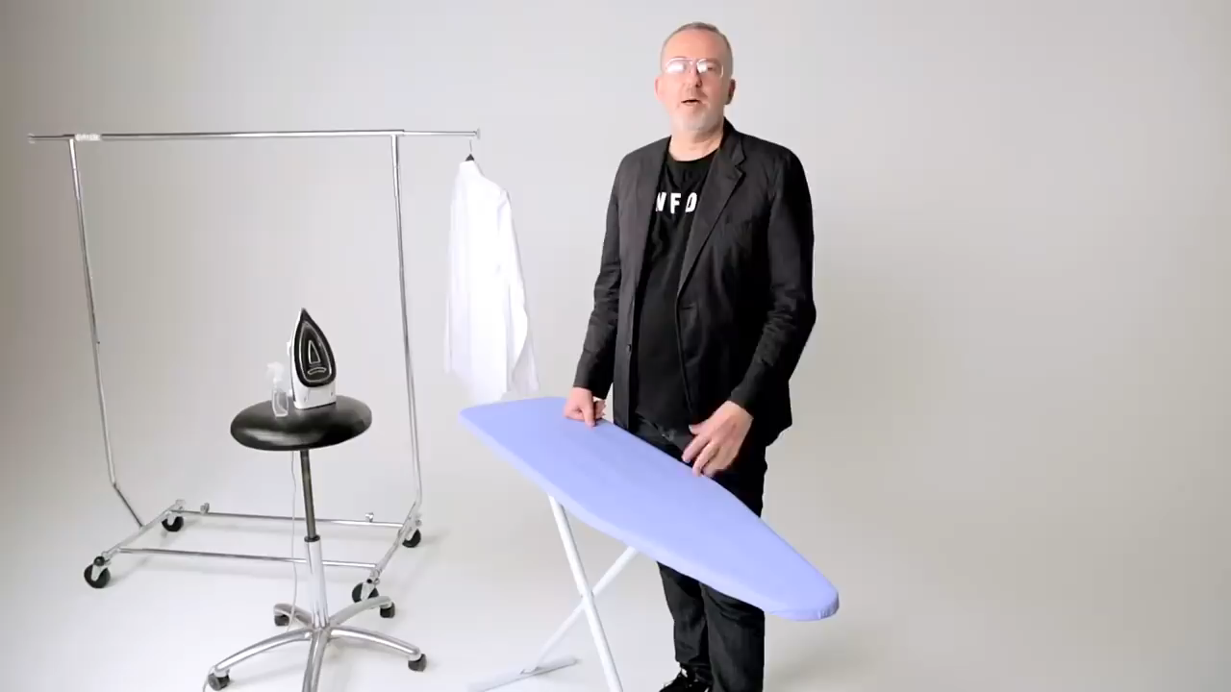
Ironing
Ironing

Slide 5
Mental Health Signs You Shouldn't Ignore
Worry and Anxiety. In our busy lives, there's always something to worry about. ...
Sleep Disturbances. A good night's sleep is an essential part of a healthy, well-balanced lifestyle. ...
Social Isolation. ...
Weight Changes. ...
Guilt and Worthlessness. ...
Mood Swings. ...
Personality Changes.

Slide 6
Other
Physical Prep
Cooking Skills

Slide 7

Sewing
Ironing

